Slide 1
Wikidata.lib
BP2013N2
InfoLunch 04.06.2014

Slide 2
Agenda

Slide 3
PubSubHubbub
PubSubHubbub (PuSH) is a protocol that enables resources to push changes to subscribers.
Notes:
Warum push?: Pushing > Polling
Warum PubSubHubbub?: Idee von WikiData

Slide 4
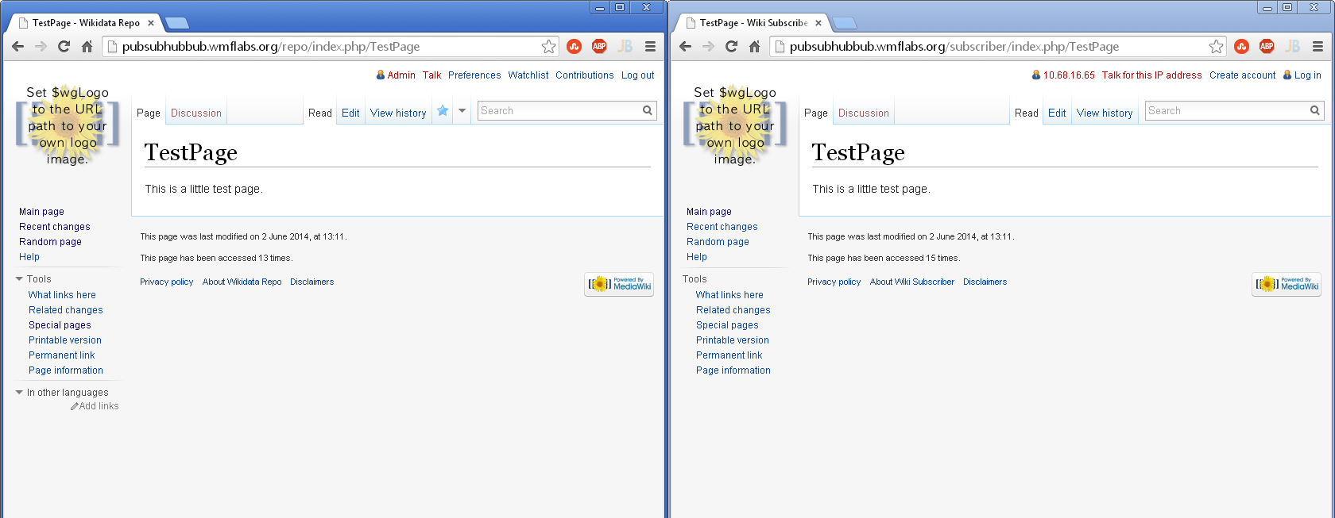
Demo

Slide 5
Detecting Changes
MediaWiki hook:
NewRevisionFromEditComplete
ArticleDeleteComplete
ArticleRevisionUndeleted
Add two new job to the JobQueue
PublishTitleChanges
PublishAllChanges
When the job is executed: Send a publish event to the hub

Slide 6
Publishing a Change
Publisher client sends an HTTP POST request to the hub
Request contains the following data:
hub.mode=publish& hub.url=http://a.resource.url/& hub.url=http://another.resource.url/ …

Slide 7
Identifying Resources
Every web page can be a resource
Resources need special HTTP headers for identification:
Link: <http://this.is.a.hub/>; rel="hub" Link: <http://this.is.the.resource/>; rel="self"

Slide 8
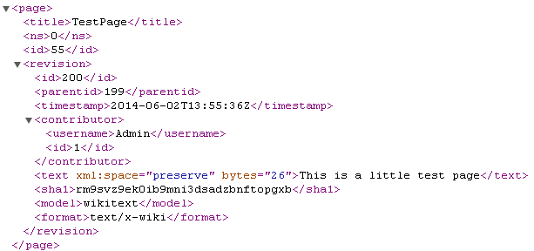
What are our Resources?
MediaWiki Export-XML
All Changes:
in the last x seconds
but y changes tops
For deletions, we export the log-entry

Slide 9
Pushing to Subscribers
Hub sends an HTTP POST request to each subscriber
Request contains special HTTP headers for identification of hub and resource:
Link: <http://this.is.a.hub/>; rel="hub" Link: <http://this.is.the.resource/>; rel="self" X-Hub-Signature: sha1=728b02d392a2bddb7d002f82012a9a8bab4feb1a
New contents of resource are body of the request
Notes:
Hub-Signature: a secret the subscriber sent to the hub when registering for a resource

Slide 10
Subscriber
Check Signature
Create WikiImporter
Register Callbacks
Delete Page Callback
Done
Do Import
Create Redirect Callback

Slide 11
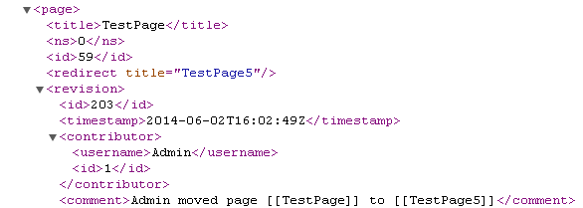
WikiImporter Issues
Parsing the redirect tag
Access to the parsed tag and the content of the tag on hooks
Stream wrapper registered resources multiple times

Slide 12
Deployment
Our publishing component is ready, except the final code review.
Mediawiki wants to take advantage of google hub.
Ask Google if they‘re ok with the load
The individual Wikipedias running behind a proxy.
need to be configured for communication with the hub
Check if there are privacy issues with the deployment on the google hub.
Probably no deployment during our bachelor project time.

